Slide 1
Inline functions

Slide 2
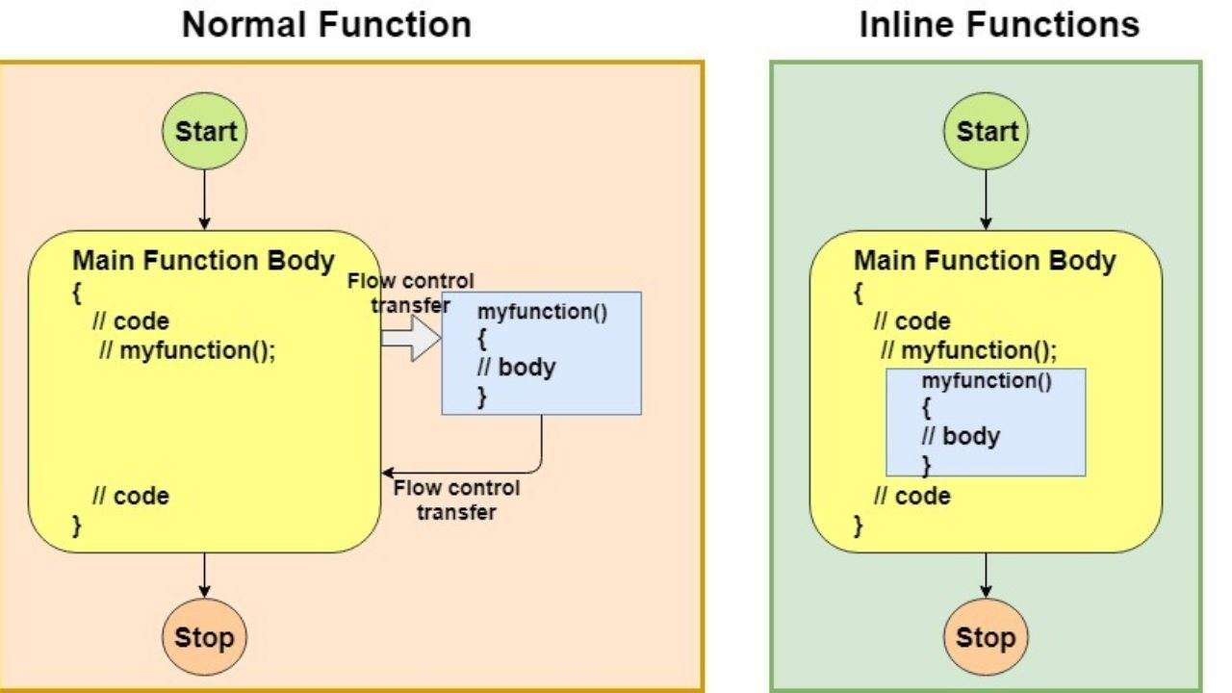
Inline Function
Inline functions are those functions whose definition is small and can be substituted at the place where its function call is made. Basically they are inlined with its function call.

Slide 3
Inline function
Syntax
inline return-type function-name(parameters)
{
// function code
}

Slide 4
Example
#include <stdio.h>
static inline int add(int a, int b)
{
return a + b ;
}
int main()
{
int a, b, x ;
printf( " Enter the value of integer a and b: " ) ;
scanf( "%d%d", &a ,&b ) ;
x = add( a , b ) ;
printf( "The result a + b : %d\n " , x ) ;
return 0 ;
}

Slide 5
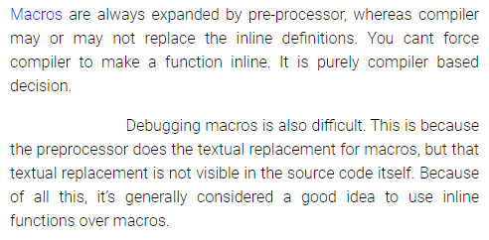
Macro Vs Inline Functions
Macros are generally used for code reuse.
Inline functions are used to eliminate the time overhead (excess time) during function call(avoiding a jump to a subroutine).

Slide 6
Macro Vs Inline Functions
Difference at compile time expansion
#include<stdio.h>
#define CUBE(b) b*b*b
int main()
{
printf("%d", CUBE(1+2));
return 0;
}
#include<stdio.h>
static inline int cube(int a)
{
return a*a*a;
}
int main()
{
printf("%d", cube(1+2));
return 0;
}

Slide 7
Macro Vs Inline Functions
Difference at argument evaluation
Difference at argument type checking
#define SQUARE(a) a*a
static inline int square(int a)
{
return a*a;
}
int main()
{
int a=3;
int b=3;
printf("%d\n", SQUARE(++a));
printf("%d\n", square(++b));
return 0;
}
#include<stdio.h>
#define SQUARE(a) a*a
static inline int square(int a)
{
return a*a;
}
int main()
{
printf("%f\n", SQUARE(1.1));
printf("%f\n", square(1.1));
return 0;
}

Slide 8
Inline recursive functions
#include<stdio.h>
static inline int fact(int a)
{
if (a<=1)
return 1;
else
return a*fact(a-1);
}
int main()
{
printf("%d\n", fact(5));
return 0;
}

